Slide 1
Project Presentation: Demo App With Docker
Presented to :
Eng. Ahmed Mourad
Eng. Zainab Awad
Presented By :
Eng. Mustafa Amer
ENG. Reham Ahmed
ENG. Ahmed Sabry
ENG. Ali Morshed

Slide 2
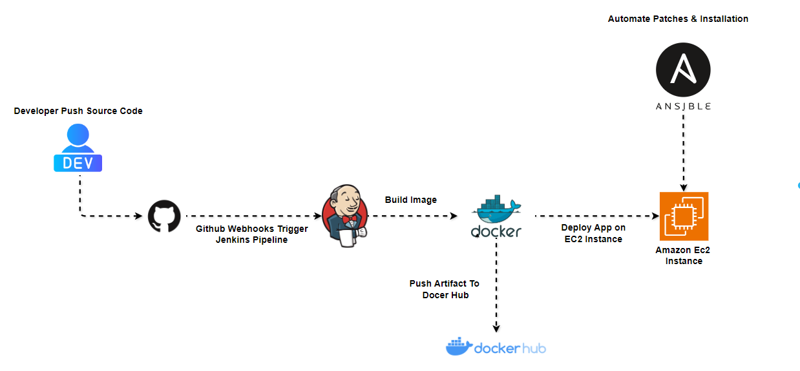
Architecture

Slide 3
Developer Pushes Code
The developer commits and pushes code to GitHub, initiating the DevOps pipeline.
Project Components:
Frontend: HTML, JavaScript, and CSS for user interaction.
Backend: Node.js with the Express framework.
Database: MongoDB for data storage.
All components are Docker-based, ensuring easy setup and consistent behavior across different environments.

Slide 4
GitHub Webhooks Trigger Jenkins
GitHub Webhooks trigger the Jenkins pipeline, automating the next steps in the process.
Benefits:
Automation: Every commit triggers an automated build/test process.
Immediate Feedback: Developers get instant feedback on whether the new code integrates smoothly.
Continuous Deployment: Jenkins can automatically deploy to environments based on the webhook trigger.

Slide 5
Jenkins Builds Docker Image
What is Jenkins?
Jenkins is an open-source automation server used to automate parts of the software development process.
Jenkins is responsible for building a Docker image based on the committed source code.
Key Features:
Extensible with plugins to support different technologies (e.g., Docker, Kubernetes).
Supports distributed builds across multiple machines.

Slide 6
Jenkins and Docker Integration
Why integrate Jenkins with Docker?
Running Jenkins inside Docker allows for easy setup and maintenance.
Jenkins can manage and run Docker containers as part of the CI/CD pipeline, providing consistent environments.
Example Setup:
1. Jenkins in Docker: Run Jenkins as a container using the official Jenkins image:
docker run -d -p 8080:8080 -p 50000:50000 jenkins/jenkins:lts
2. Building with Docker in Jenkins: Use Docker agents to execute CI/CD pipelines within containers.

Slide 7
Jenkins Pipelines
What is a Jenkins Pipeline?
Jenkins Pipelines define the stages of the CI/CD process.
Pipelines are written in Jenkinsfile, a text file that contains the steps for building, testing, and deploying.
Sample Jenkinsfile:
pipeline {
agent any
stages {
stage('Build') {
steps {
sh 'docker build -t my-app .'
}
}
stage('Test') {
steps {
sh 'docker run my-app npm test'
}
}
stage('Deploy') {
steps {
sh 'docker push my-app:latest'
}
}
}
}

Slide 8
Steps to Start the Application with Docker
FROM node:13-alpine
ENV MONGO_DB_USERNAME=admin \
MONGO_DB_PWD=password
RUN mkdir -p /home/app
COPY ./app /home/app
# set default dir so that next commands executes in /home/app dir
WORKDIR /home/app
# will execute npm install in /home/app because of WORKDIR
RUN npm install
# Expose the port the app runs on
EXPOSE 3000
# no need for /home/app/server.js because of WORKDIR
CMD ["node", "server.js"]

Slide 9
Accessing the Application
1. Access App:
Visit: http://localhost:3000

Slide 10
Docker Image Pushed to Docker Hub
Once the Docker image is built, it is pushed to Docker Hub for containerization and future use.
Benefits of Pushing Images to Docker Hub:
Easy Sharing: Allows you to share your application container with other developers or collaborators.
Centralized Repository: Serves as a centralized place for storing multiple versions of your image.
CI/CD Integration: Docker Hub can be integrated with Continuous Integration/Continuous Delivery (CI/CD) pipelines for automatic image builds and deployments.

Slide 11
Utility App
# Dockerfile for the MongoDB initialization container
FROM node:16-alpine
# Create app directory
WORKDIR /usr/src/app
# Copy the script to the container
COPY init-mongo.js .
# Install MongoDB client library
RUN npm install mongodb
# Run the script
CMD ["node", "init-mongo.js"]

Slide 12
Introduction to Docker Compose
What is Docker Compose?
Docker Compose is a tool for defining and running multi-container Docker applications.
It uses a YAML file to configure services, networks, and volumes.
Key Features:
- Simplifies multi-container setups.
- Automatically manages dependencies between services.

Slide 13
Example Setup in docker-compose.yaml
This example defines two services: MongoDB and Mongo-Express.
version: '3'
services:
mongodb:
image: mongo
ports:
- 27017:27017
environment:
- MONGO_INITDB_ROOT_USERNAME=admin
- MONGO_INITDB_ROOT_PASSWORD=password
volumes:
- mongo-data:/data/db
mongo-express:
image: mongo-express
ports:
- 8080:8081
environment:
- ME_CONFIG_MONGODB_ADMINUSERNAME=admin
- ME_CONFIG_MONGODBADMINPASSWORD=password
depends_on:
- "mongodb"

Slide 14
Docker Compose Concepts
1. Services
Define multiple containers in the `services` section.
Each service can include images, ports, environment variables, and volumes.
2. Volumes
Used to persist data across container restarts.
In this example, MongoDB's data is stored in `mongo-data`.
3. Dependencies
The `depends_on` option ensures that Mongo-Express waits for MongoDB to start.

Slide 15
App Deployed on EC2 Instance
The app is deployed on an Amazon EC2 instance, utilizing the Docker image.
Access the Deployed App: Once the app is running, it can be accessed via the EC2 instance’s public IP or DNS name using a web browser (e.g., http://<EC2-public-IP>:<app-port>).
Benefits of EC2 for Deployment:
Scalability: Easily scale up or down as needed.
Flexibility: Full control over the instance’s environment.
Security: Secure app deployments through firewalls and VPCs (Virtual Private Cloud).

Slide 16
Ansible Automates Patches & Installation
What is Ansible?
Ansible is an open-source automation tool used for configuration management, software provisioning, and application deployment.
It uses YAML-based playbooks to define tasks and can manage systems remotely over SSH without the need for agents.

Slide 17
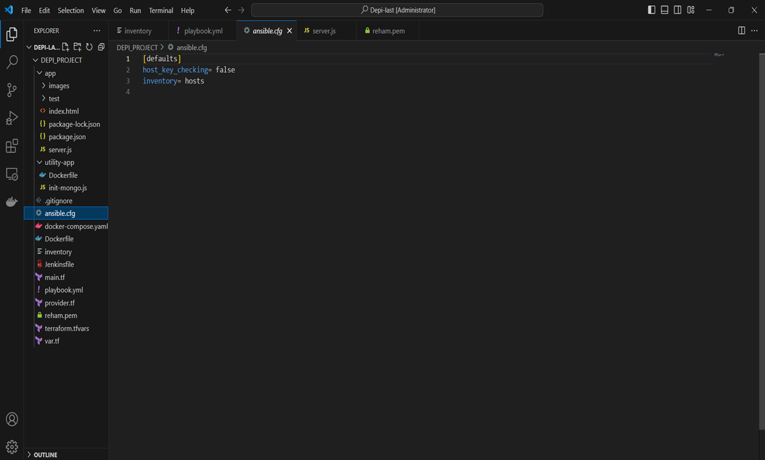
How Ansible Automates Patches
Ansible automates the process of updating software packages and applying security patches across multiple servers.

Slide 18
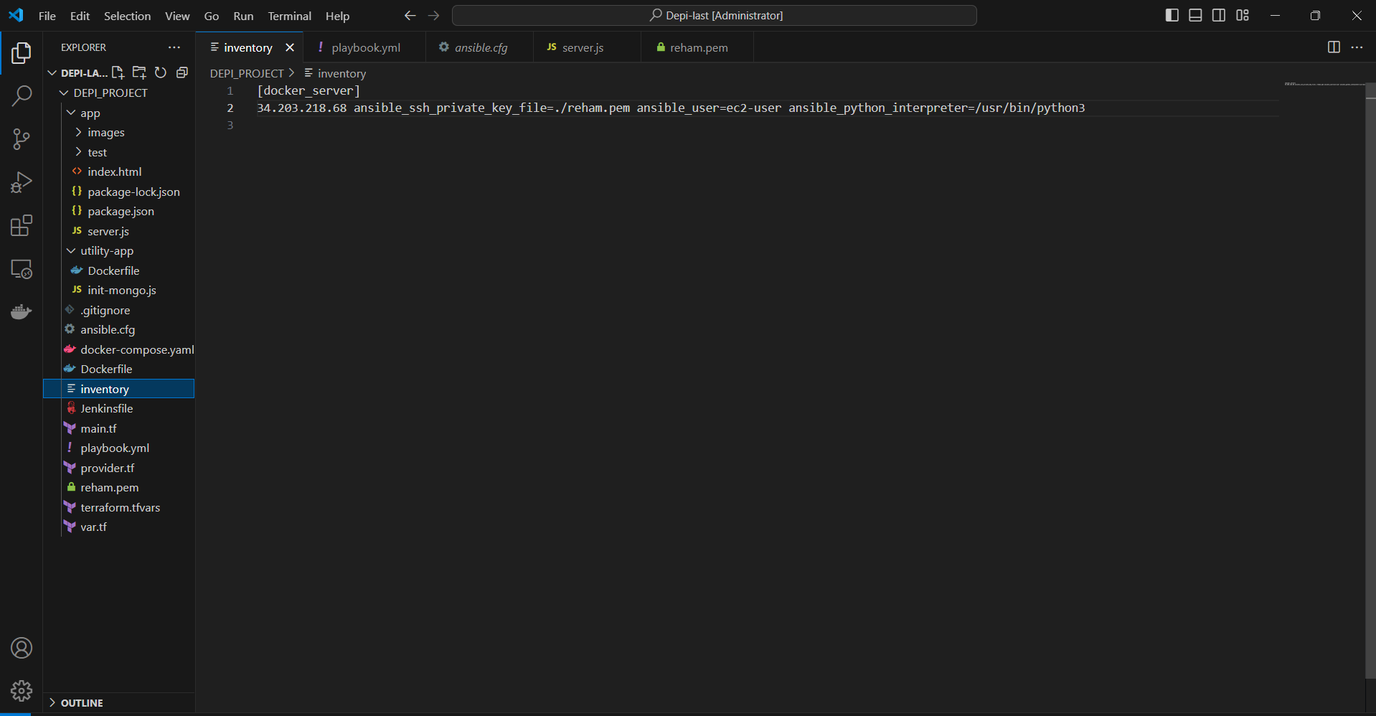
How Ansible Automates Software Installation

Slide 19
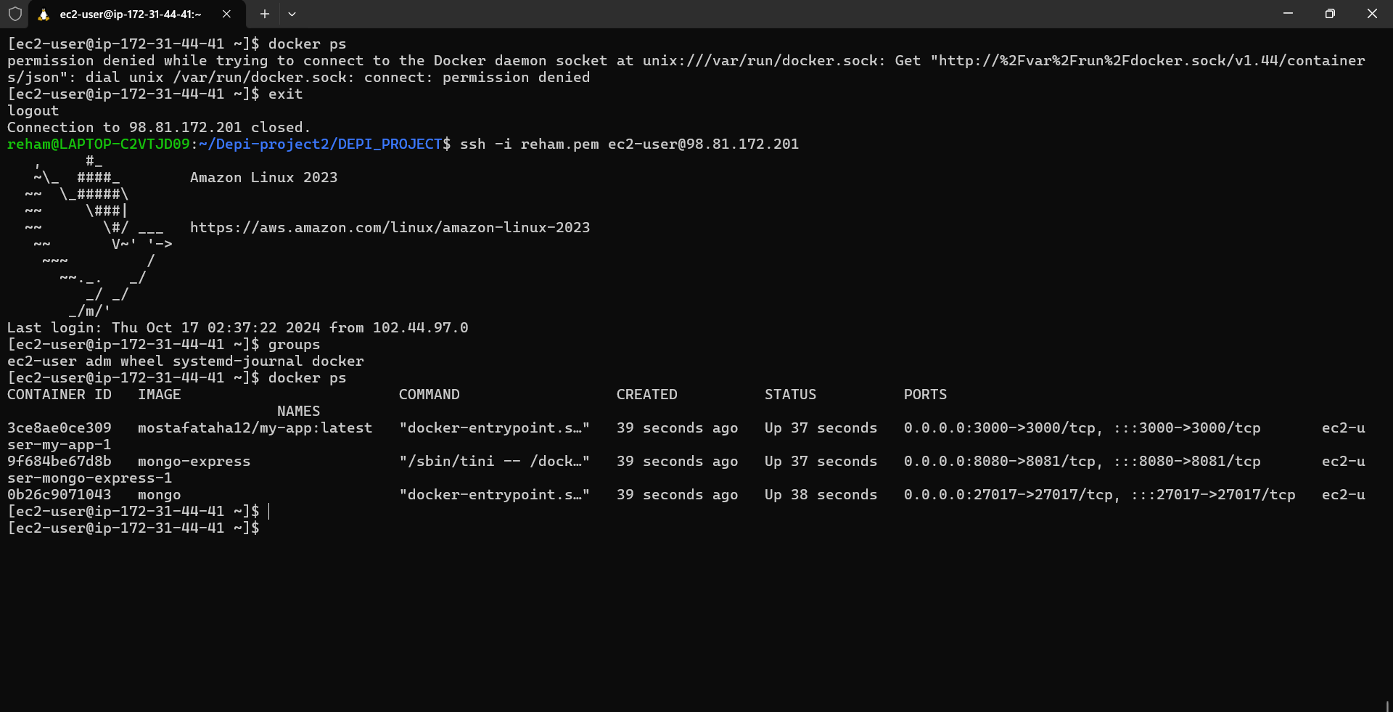

Slide 20
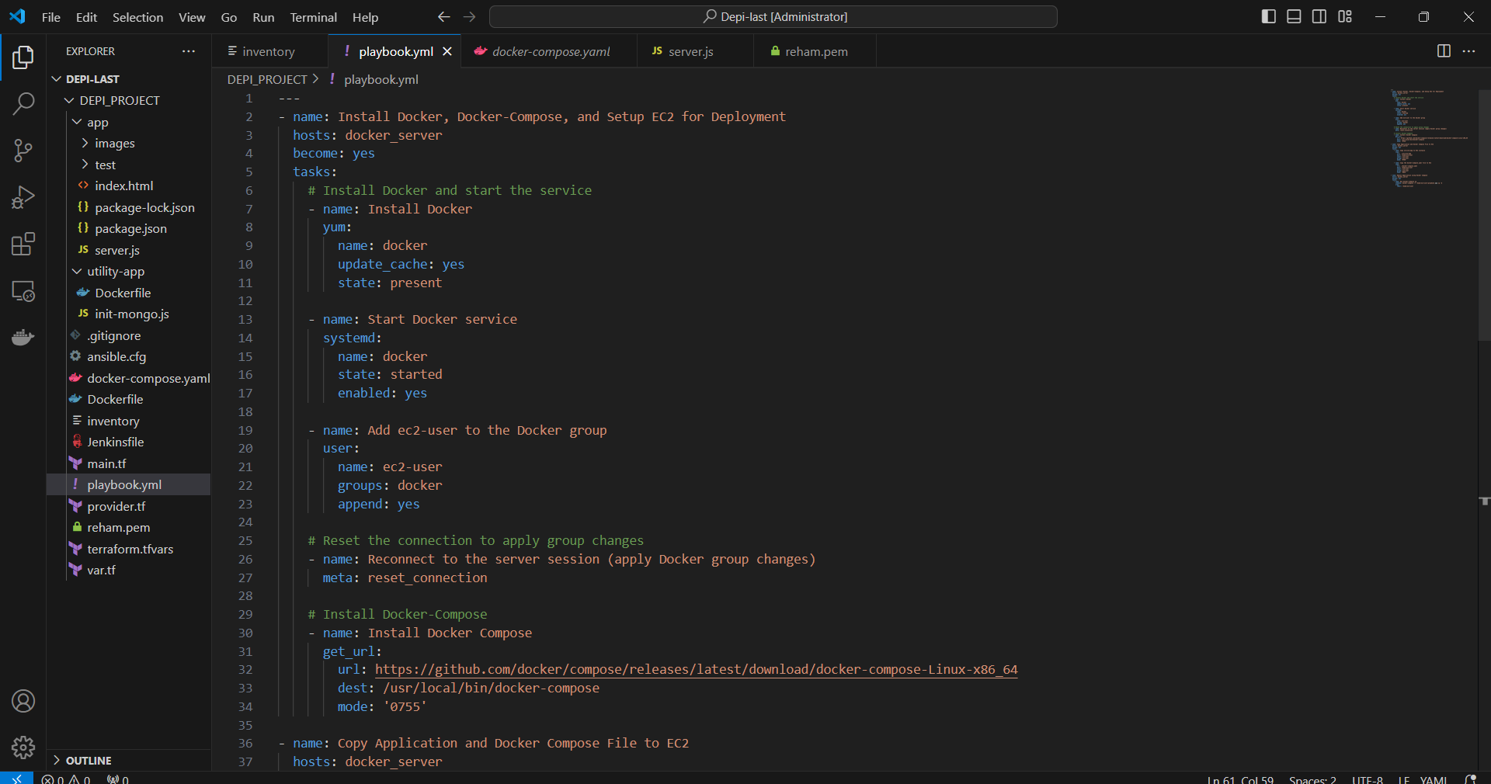

Slide 21
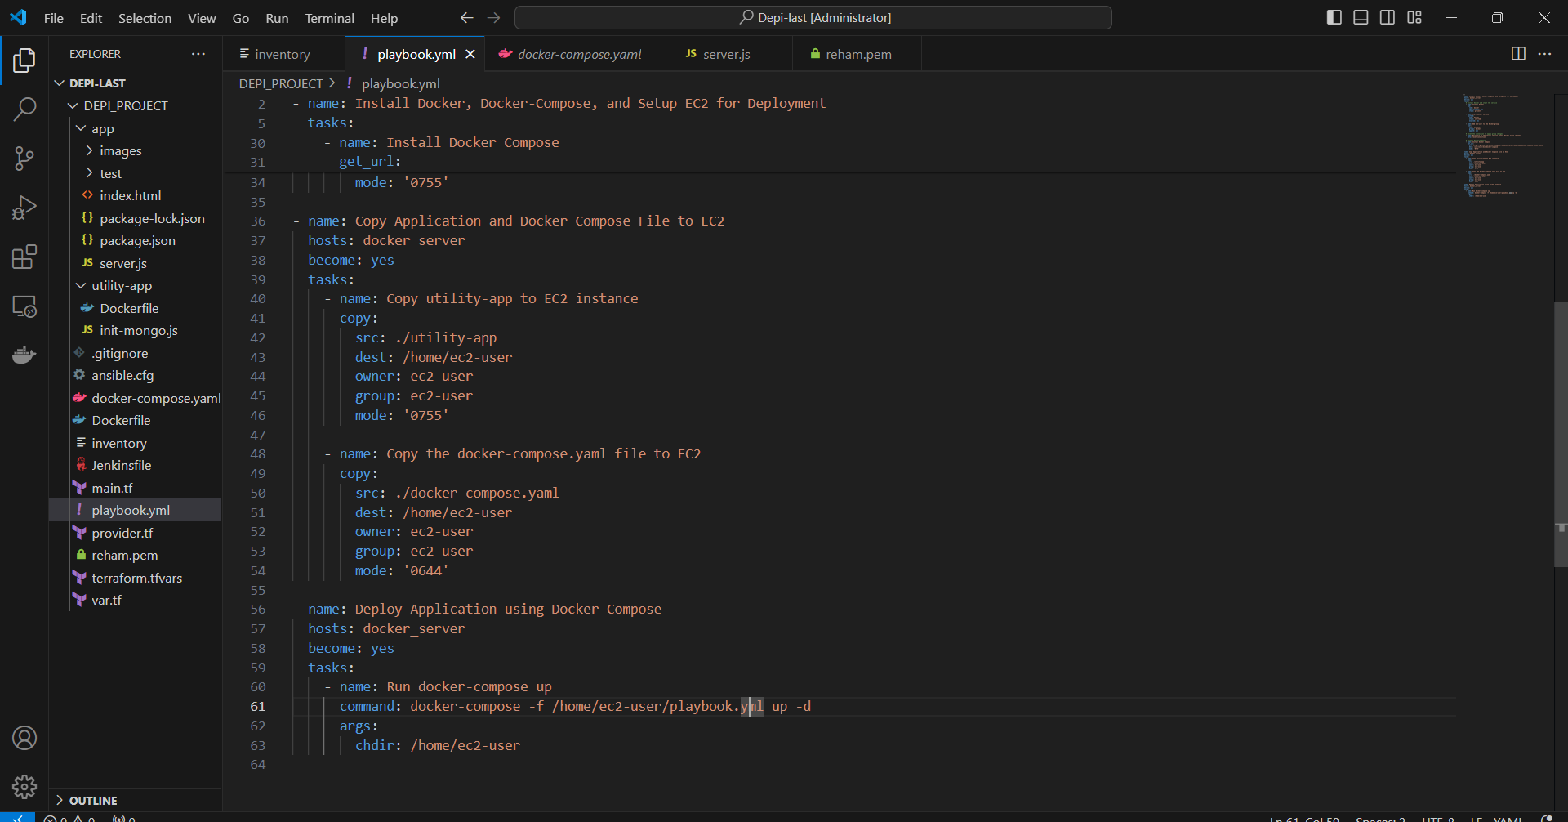

Slide 22
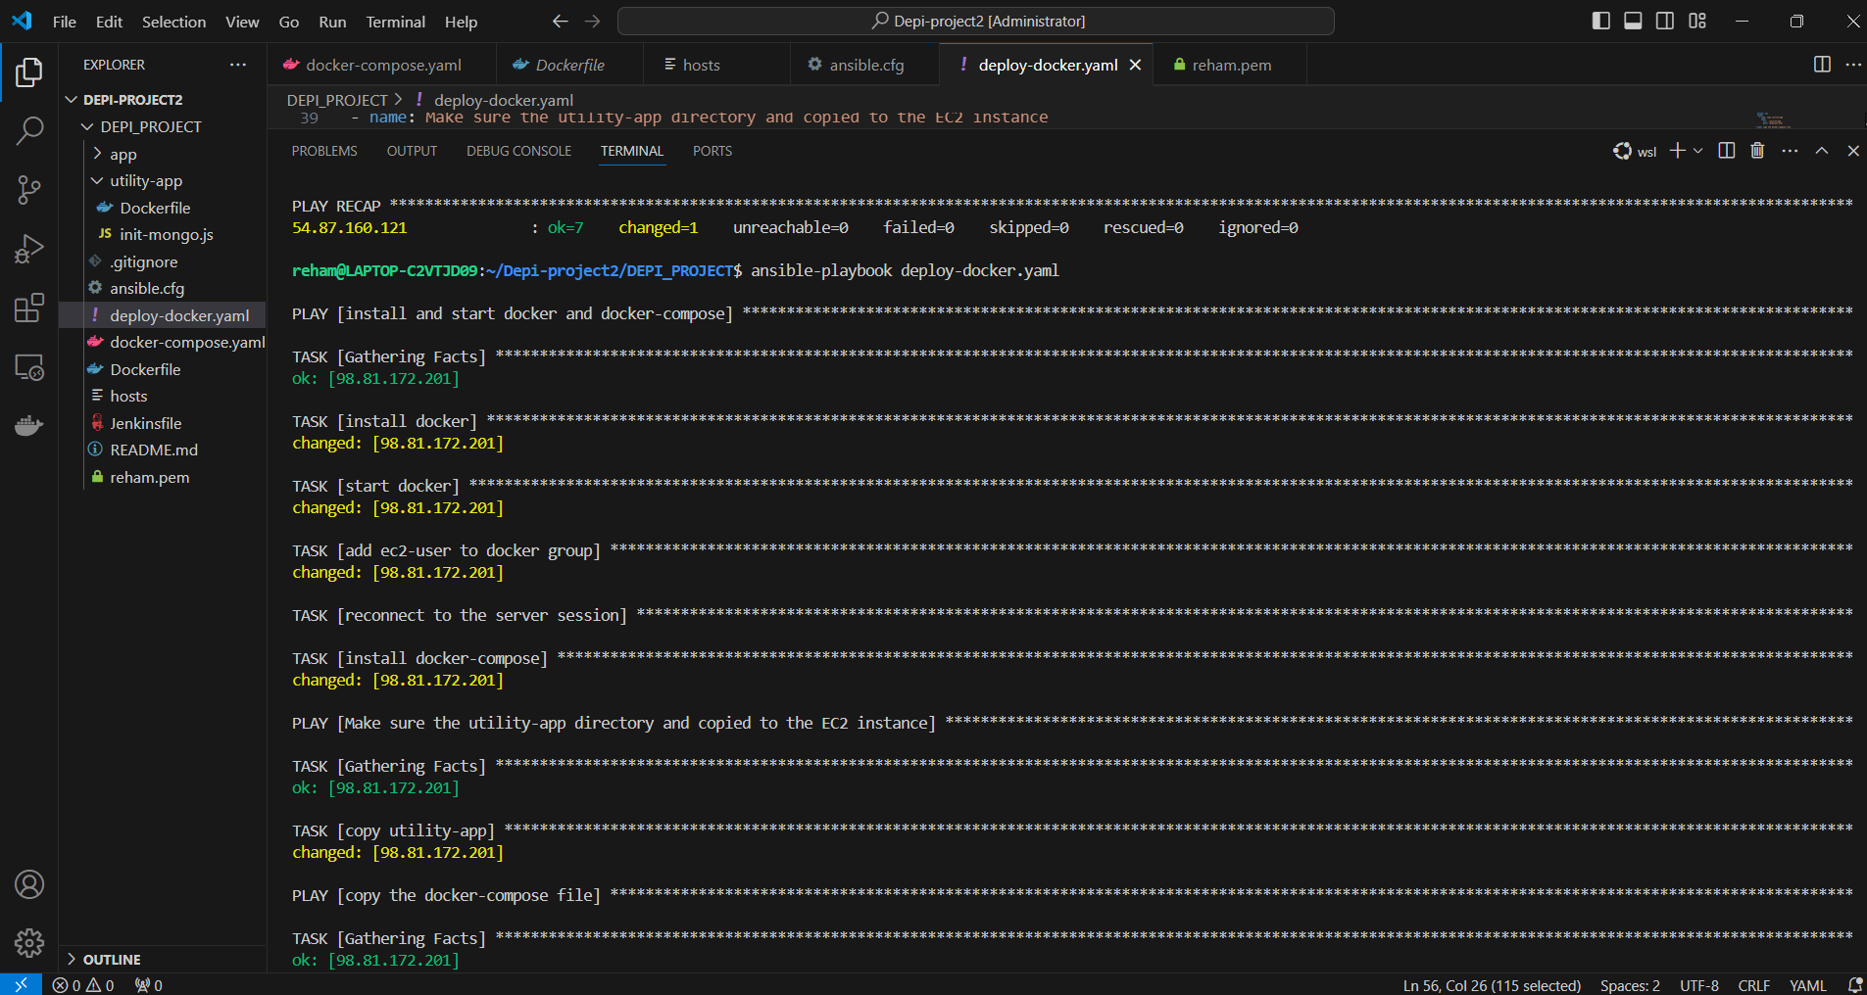

Slide 23
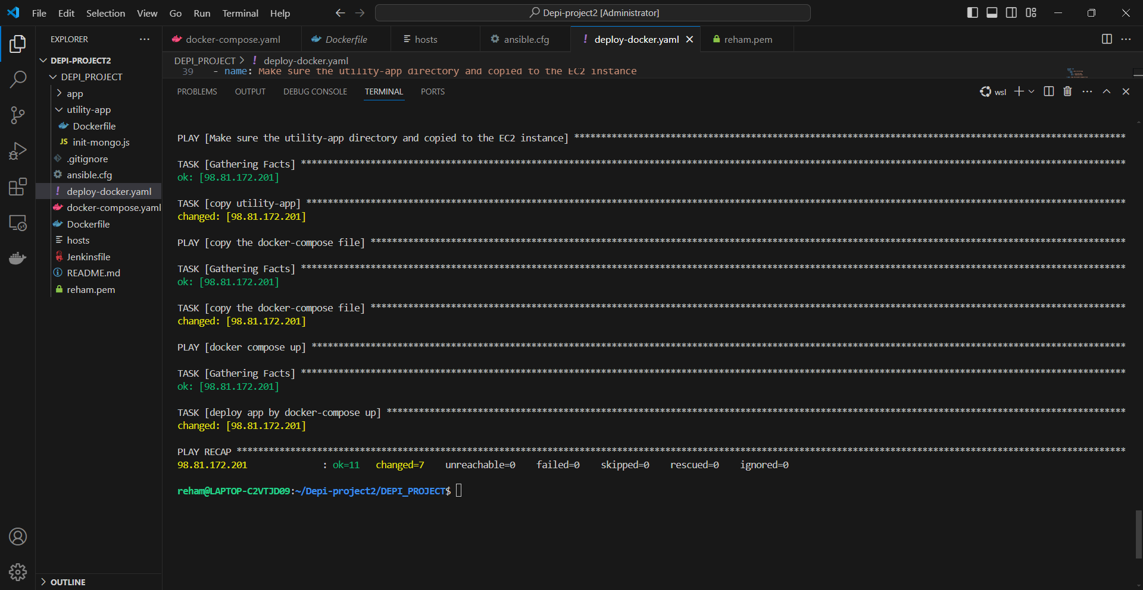

Slide 24
Benefits of Using Ansible for Automation
- Consistency: Ensures that patches and installations are applied uniformly across all servers.
- Scalability: Manages updates and installations across a large number of machines efficiently.
- Reduced Downtime: By automating routine tasks, it minimizes human errors and reduces downtime during patching or setup.

Slide 25


